Slide 1

Subscription based chat application Organization: Grameen Communications Designation: Software Developer Intern Joining Date: 13/03/2022
Name: Rafid Al Ahsan
ID: 1722006
Spring 2022

Slide 2
Problems I wish to solve during internship
Establish a fast and reliable communication system
Reduce communication gaps
Ensuring all private information remains within the company
Reducing any security issues (signup verifications)

Slide 3
What I wish to learn during my Internship
Technologies
HYML5
CSS3
Bootstrap 5
Modern JavaScript
Vue JS 3(Frontend Framework)
MySQL Database
PHP-Laravel Framework
Soft Skills
Teamwork
Punctuality
Time Management
Office Culture
Building a network
Develop strong communications skills
Software
Microsoft Word
Adobe Photoshop

Slide 4
After joining what I have learned so far
Business Requirement Diagram
Creating the front-end graphical user interface of chat application
Brainstorming and Mind mapping
Time Management for a given project
Preparing documentation and training manual
Getting used to office culture and environment
Created an Excel sheet containing information of all frontend and backend technologies
Created and CRUD application using Laravel and Vue.js 3

Slide 5
Final Expected Outcomes
An easy to use and beautiful looking chat application
Login and signup pages
Verification on signup
Fast messaging between users

Slide 6
My contribution in the whole project
Analysing project requirements
Preparing business report diagrams
Creating the frontend the backend of the system
Solving any bugs or development related issues

Slide 7
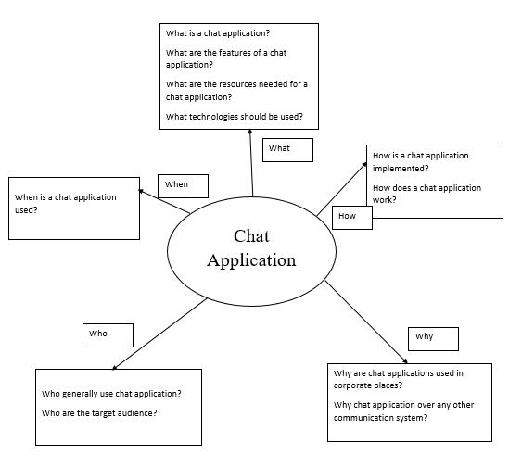
Mind map

Slide 8
Thank
you

